Slide 1
Code Search Engine
Marcus Stewart, Daniel Gilley, Arman Bahraini, Robert Wenger

Slide 2
Project Description and Requirements

Slide 4
High Level Design

Slide 5
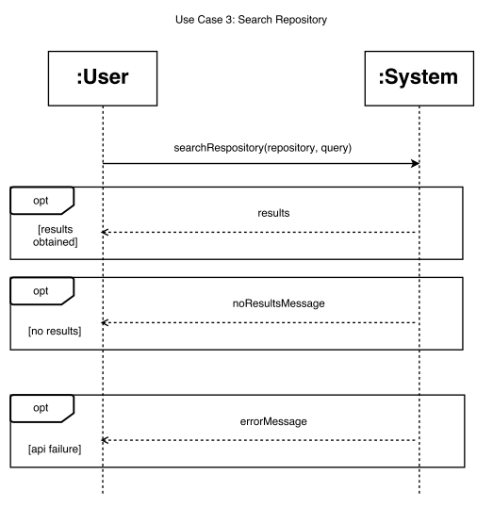
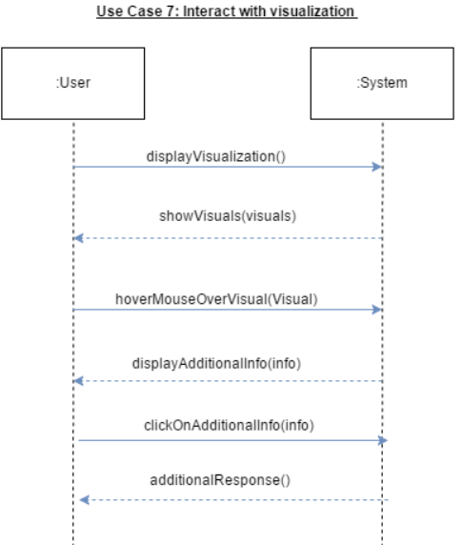

Slide 6
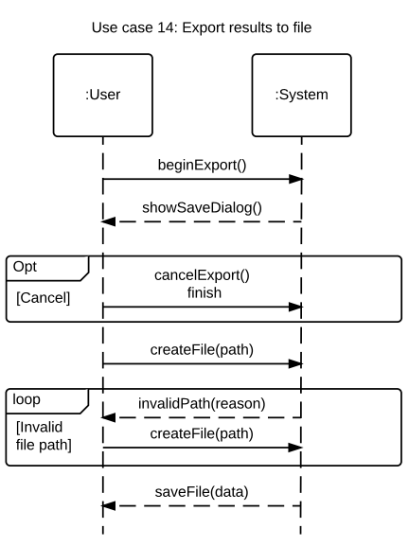
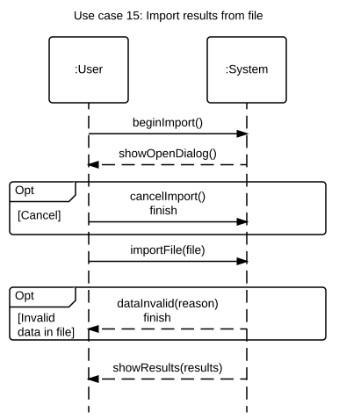

Slide 7
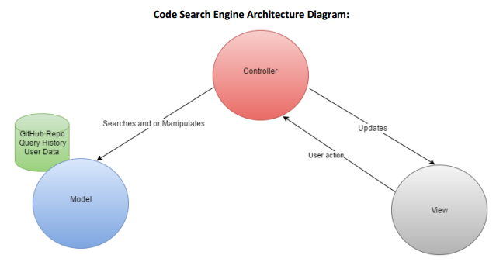

Slide 8
Detailed Design

Slide 9
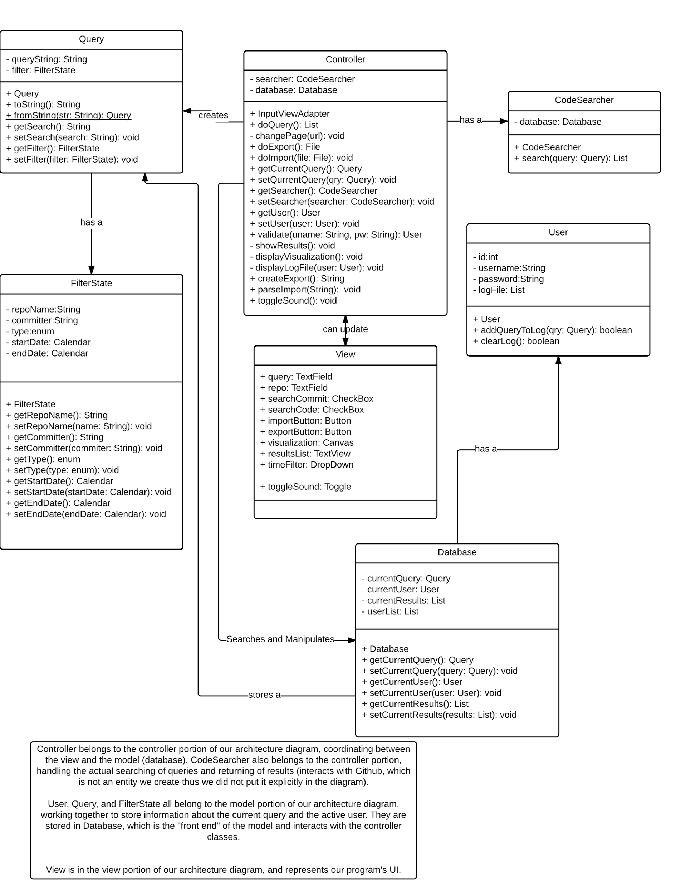
Class Diagram

Slide 10
Demonstration

